Slide 1
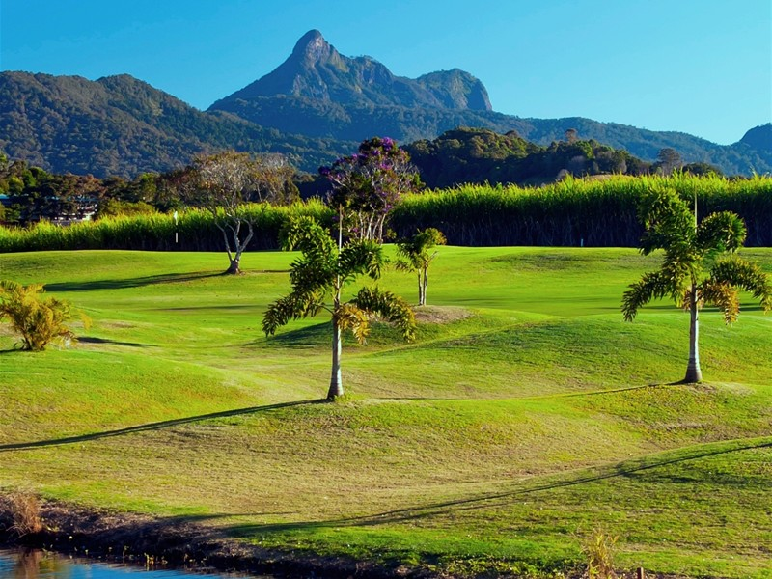







BACK
MARKER
CHALLENGE
BOOK NOW:
(02) 66724200
First Friday Each Month
Members $15 Visitors $50
1st Prize: Golf Bag
2nd Prize: Shirt and Dozen Pro V1 Balls
3rd Prize: Cap and Glove Supported by:
Best Gross: $50 Member Account Voucher
4 x NTPs: $20 Member Account Voucher
END OF YEAR FINAL - (Fri 6th December 2024):
Top 3 Nett + Gross Monthly winners are invited back to play for a:
Best Nett: 7-piece custom set of irons ($2,300 VALUE)
Men’s Blue Tees SCR 72, Par 71, Slope 132
OPEN AGAIN TO LADIES WITH AN OFFICAL G.A. HANDICAP OF 29.3 or LESS! Ladies White Tees SCR 78, Par 73, Slope 132

Slide 2
BACK
MARKER
CHALLENGE
BOOK NOW:
(02) 66724200
First Friday Each Month
Members $15 Visitors $50
1st Prize: Golf Bag
2nd Prize: Shirt and Dozen Pro V1 Balls
3rd Prize: Cap and Glove Supported by:
Best Gross: $50 Member Account Voucher
4 x NTPs: $20 Member Account Voucher
END OF YEAR FINAL - (Fri 6th December 2024):
Top 3 Nett + Gross Monthly winners are invited back to play for a:
Best Nett: 7-piece custom set of irons ($2,300 VALUE)
Men’s Blue Tees SCR 72, Par 71, Slope 132
OPEN AGAIN TO LADIES WITH AN OFFICAL G.A. HANDICAP OF 29.3 or LESS! Ladies White Tees SCR 78, Par 73, Slope 132

Slide 3
BACK
MARKER
CHALLENGE
BOOK NOW:
(02) 66724200
First Friday Each Month
Members $15 Visitors $50
1st Prize: Golf Bag
2nd Prize: Shirt and Dozen Pro V1 Balls
3rd Prize: Cap and Glove Supported by:
Best Gross: $50 Member Account Voucher
4 x NTPs: $20 Member Account Voucher
END OF YEAR FINAL - (Fri 6th December 2024):
Top 3 Nett + Gross Monthly winners are invited back to play for a:
Best Nett: 7-piece custom set of irons ($2,300 VALUE)
Men’s Blue Tees SCR 72, Par 71, Slope 132
OPEN AGAIN TO LADIES WITH AN OFFICAL G.A. HANDICAP OF 29.3 or LESS! Ladies White Tees SCR 78, Par 73, Slope 132

